Slide 1



Unity Collaboration
By Henry Bryant

Slide 2
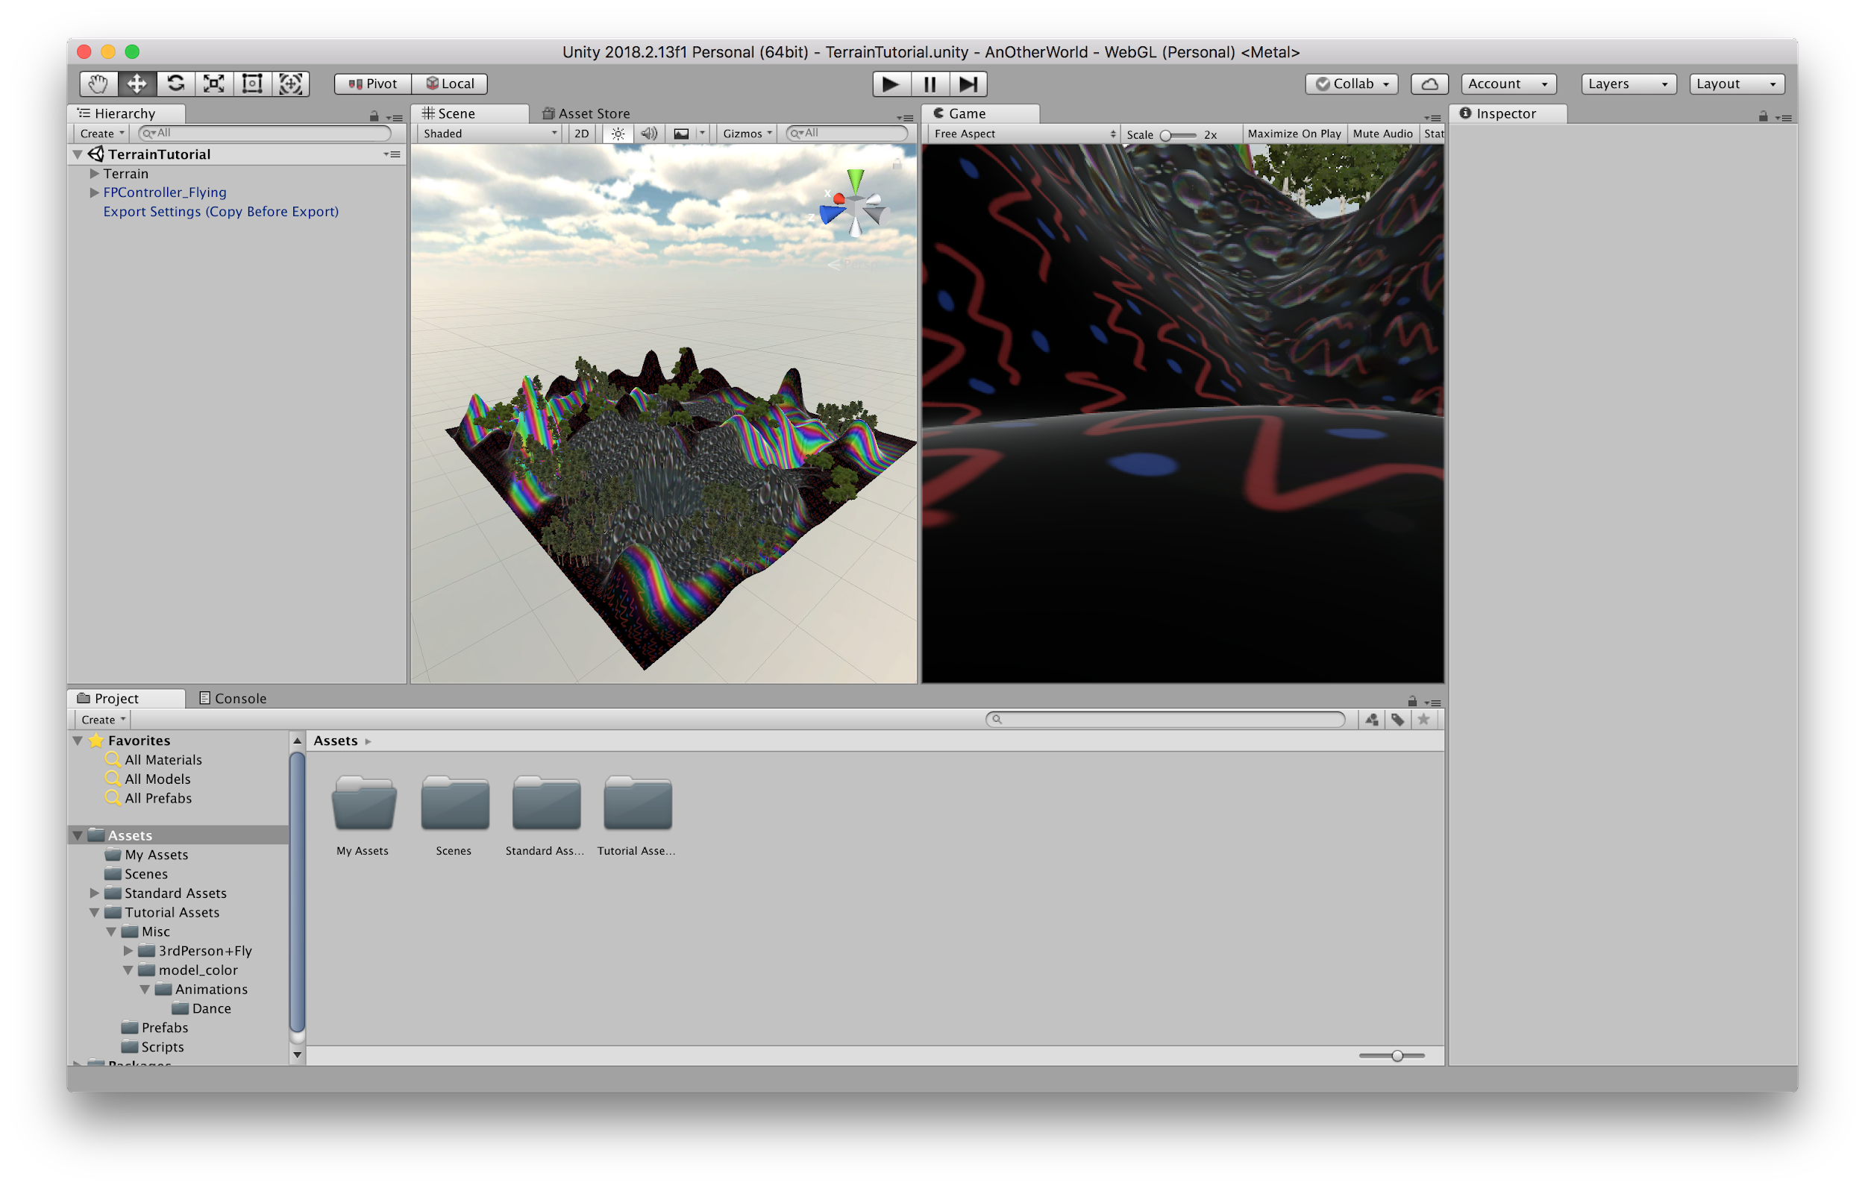
Recap - Unity Basics
Tutorial with Oscar Keyes

Slide 3
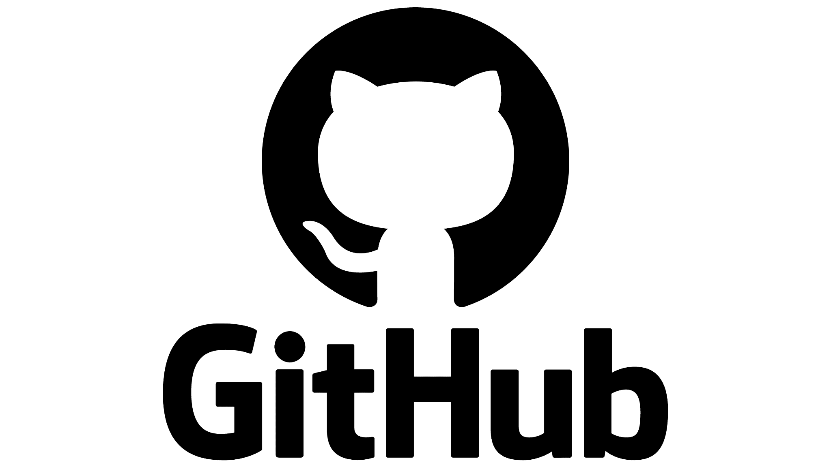
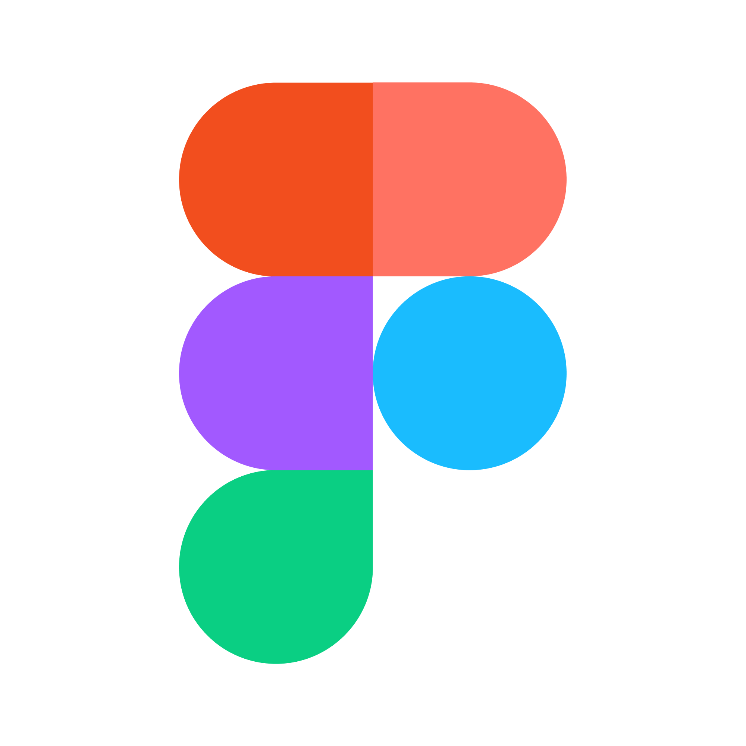
Unity Collaboration Tools
Github is a developer platform that allows developers to create, store, manage and share their code.
Figma focuses on user interface and user experience design, with an emphasis on real-time collaboration

Slide 4
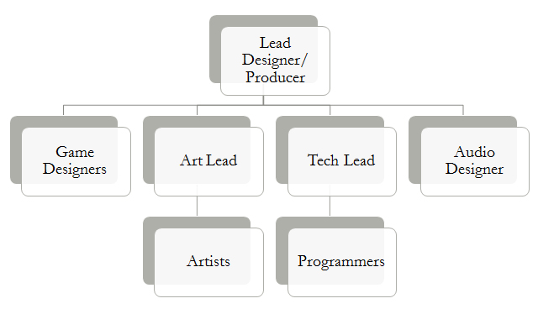
Conventions & Standard Team Layout
Programmer I
Programmer II
3D Artist
3D/2D Artist
Sound + Story (Game Design)
Animation/Rigging + Story
Notes:
The graphic shows how a typical game studio organizes for game development within Unity. In our case we are likely going to have people who hold multiple titles or share positions such as ‘lead’.

Slide 5
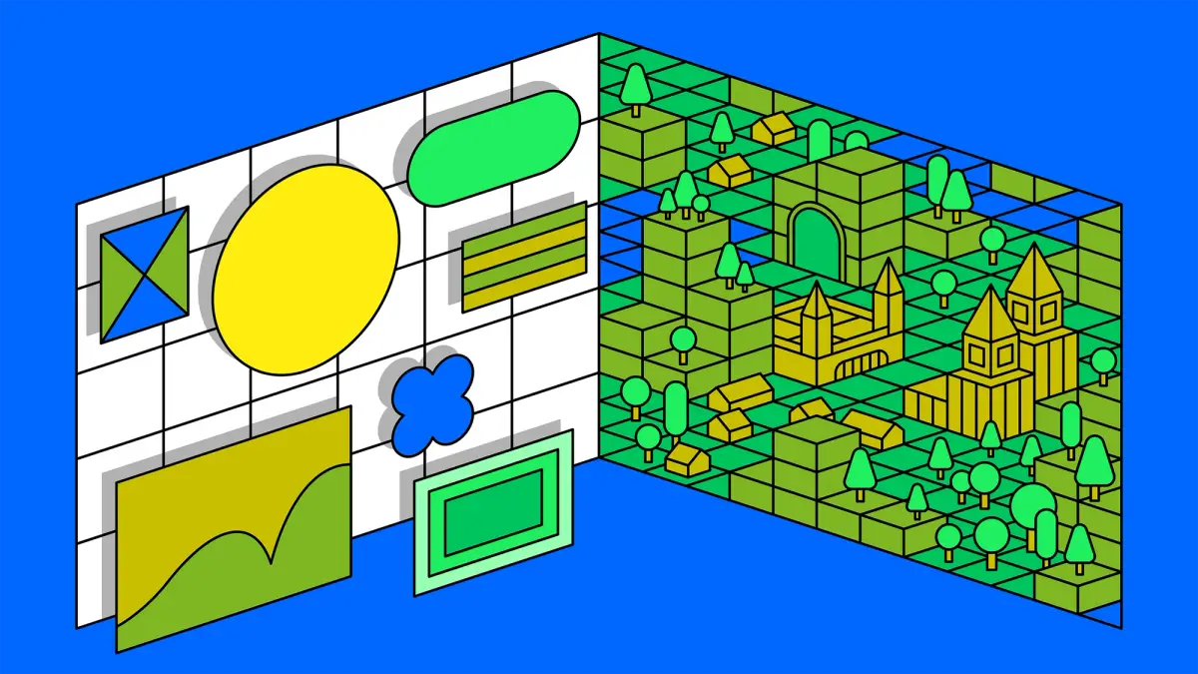
Figma as a Collaboration Tool
Inspirations
Work Schedules
To Do
Voting on Ideas
Script / Story

Slide 6
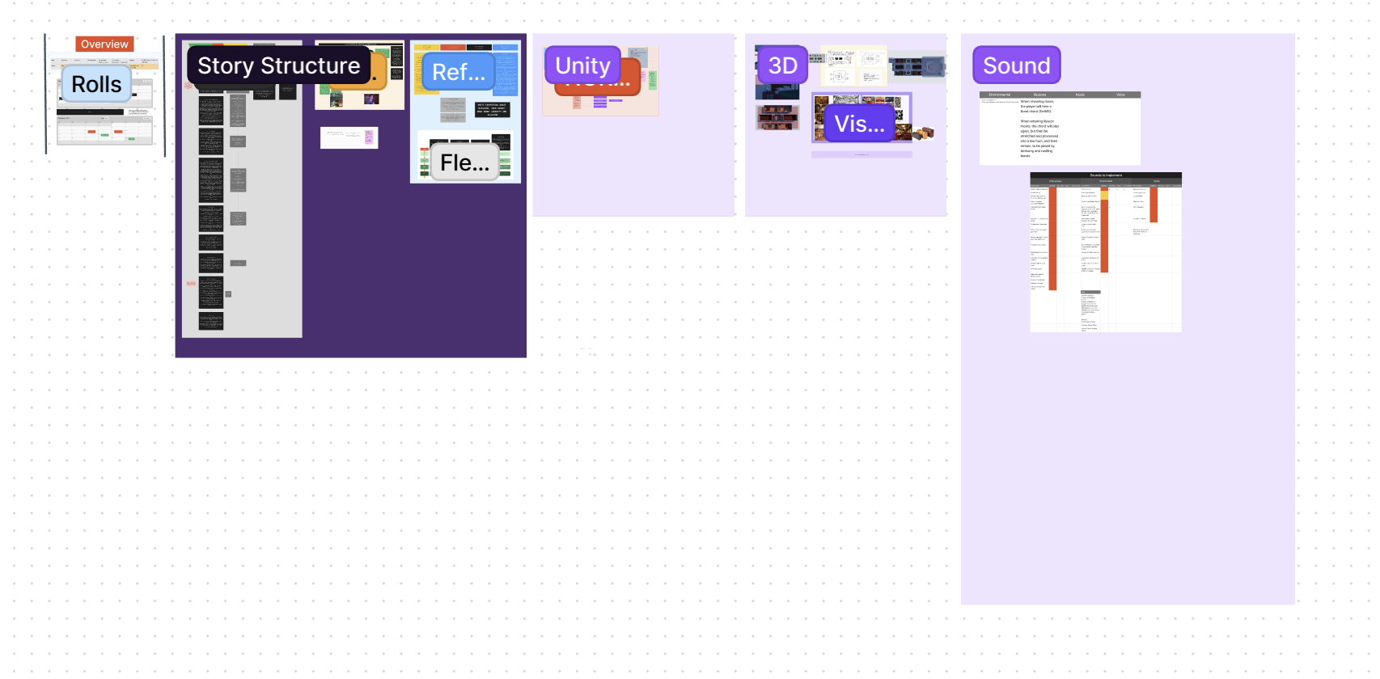
Figma Walkthrough

Slide 7
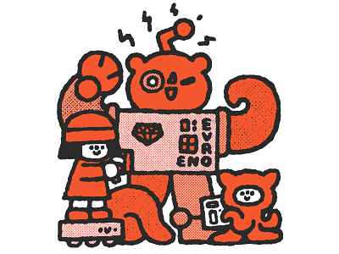
GitHub as a Collaboration Tool
Version Control
Backup & Recovery
Sharing Work

Slide 8

GitHub Walkthrough

Slide 9


Other Collaboration Tools
Discord is an instant messaging and VoIP social platform which allows communication through voice calls, video calls, text messaging, and media and files.
Google Drive is a file storage and synchronization service developed by Google.

